Slide 1


River's Edge POC Workshops
August 15 - 17, 2017

Slide 2
Mark Intro

Slide 3
”Reimagine” slide

Slide 4
Leadership Team
Experienced, Fortune 500 companies IBM, AOL & Silicon Valley Startups
Mike Smith
20+ years IT and consulting, spanning enterprise transformation, system modernization & business process re-engineering. Mike leads business development and overall corporate strategy.
Sam Peter
25+ years technical analysis, design, and systems development experience in complex enterprise transformation efforts. Sam leads Your Way’s Artificial Intelligence Practice.
Bob Roberts
25+ years building and advising fast growing technology companies with emphasis on corporate strategy, operations, partnerships and M&A. Bob focuses on corporate and product strategy at Your Way.
Alex Adams
16+ years experience architecting, developing and deploying custom web applications, portals & enterprise system integration. Alex leads internal product development.
Scott Dunn
25+ year career building and implementing data driven solutions in the Insurance and Education industries. Scott leads product strategy for Your Way Claims.
Jim James
17+ years experience in UX research, strategy & design across various industries, and practice & business development. Jim leads internal UX product design.

Slide 5



Our DNA
+
+
Artificial Intelligence
ServiceNow Cloud
User Experience

Slide 6

AI-infused end-to-end claims management and customer portal
YourWay Claims
Claims Management
Watson-powered natural language processing, sentiment/tone analysis; predictive analytics; robotic process automation
Automate workflow, enhance insight, reduce cost/accelerate resolution

Slide 7



Virtual Assistant
Sentiment Analysis
Smart Routing + Assignment
Smart Data Visualization
Character Recognition
Bob
Sammie
Alec
Annie
Oscar
Your Way Claims Baseline
ServiceNow Platform
Full combination of ServiceNow, Your Way Claims + AI Products

Slide 8
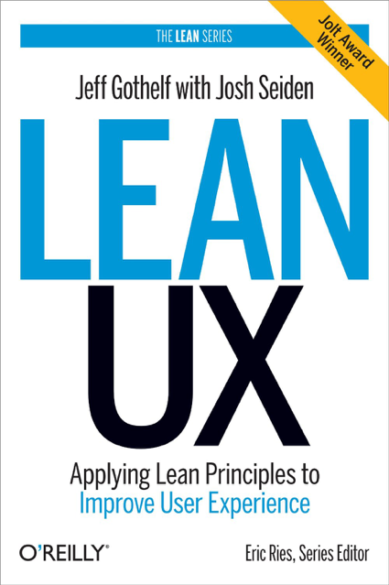
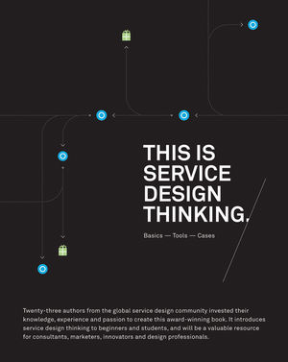
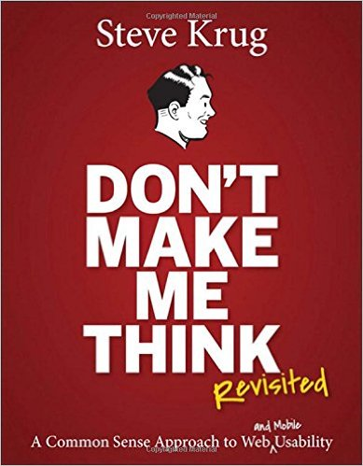
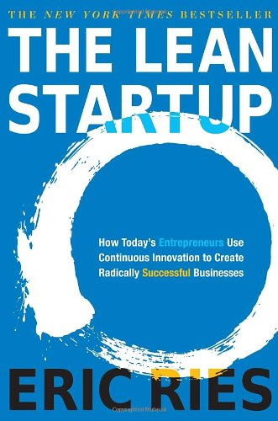


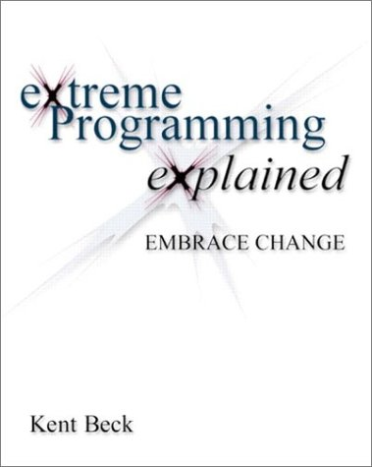
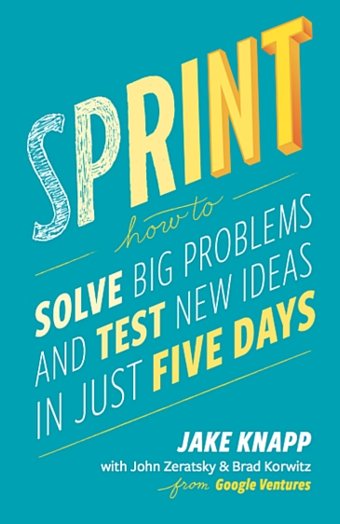
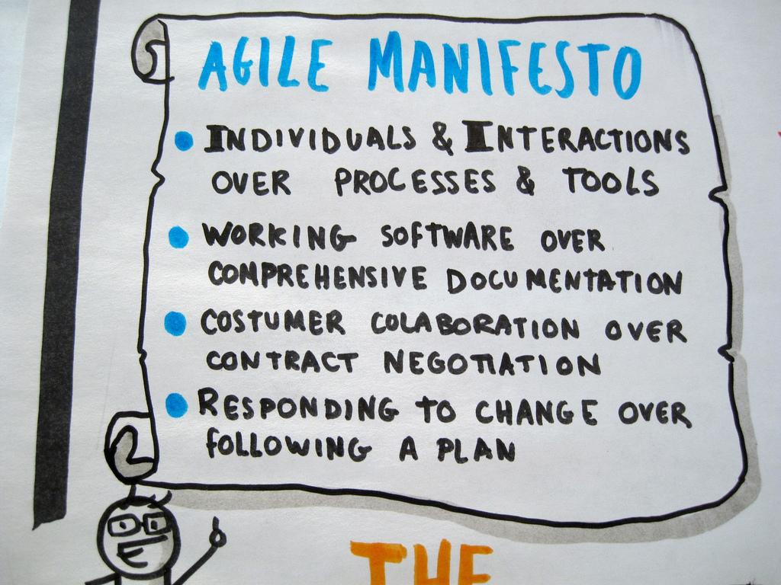
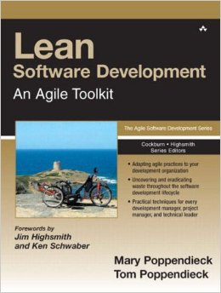

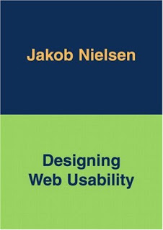
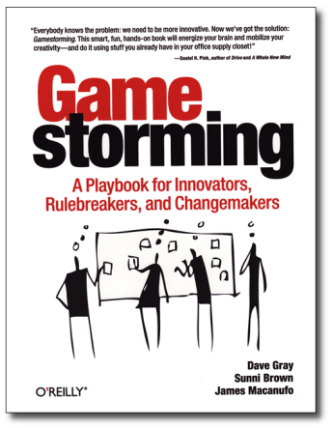
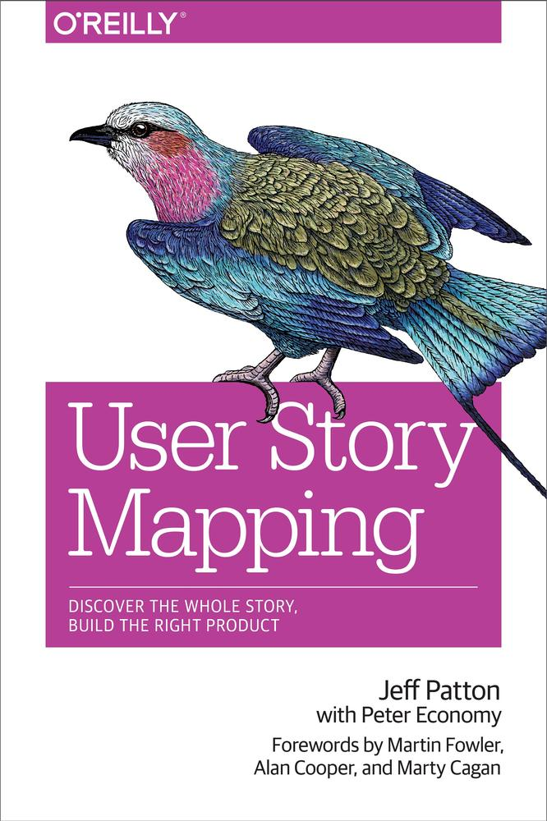
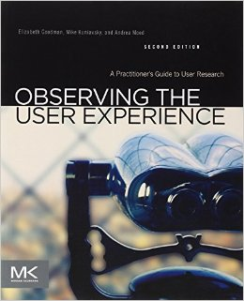
Our Roots

Slide 9
Core Principles
Get to a shared understanding, quickly
1
Often best done visually; talk more than write
Focus on outcomes, and the right outputs
2
Work together to understand the desired goals and objectives, then determine the right amount of documentation and deliverables
Design and build together
3
Definitely cross-functional; with clients involved throughout
Always be learning, with real users
4
User research, usability testing, reviewing data and analytics is still fundamental

Slide 10
Quick Demo (Bob)

Slide 11
Q&A
What do you think? Questions?

